Slide 1
Diagrams used on integration overview articles

Slide 2














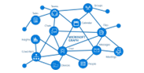







Connect apps
Built-in Apps
Microsoft AppSource
Shopify
AMC Banking
365
Microsoft 365
Power Platform
Microsoft Azure
Microsoft foundational
services
Dynamics 365

Slide 3
Microsoft 365
Business Central

Slide 4
Business Central
Power Platform

Slide 5
Business Central
Dataverse

Slide 6
Microsoft Word
Microsoft Excel
Business Central
Microsoft Outlook
Microsoft Teams
Onedrive for Business
Microsoft SharePoint
Microsoft Graph

